Slide 1
Lecture 4
Topics
  Boolean Algebra
  Huntington’s Postulates
  Truth Tables
  Graphic Symbols
  Boolean Algebra Theorems

Slide 2
Boolean Algebra
Notes:
From Vahid

Slide 3
Boolean Algebra
A fire sprinkler system should spray water if high heat is sensed and the system is set to enabled
  Let Boolean variable h represent “high heat is sensed,” e represent “enabled,” and F represent “spraying water.” Then an equation is:
  F = h AND e
A car alarm should sound if the alarm is enabled, and either the car is shaken or the door is opened
  Let a represent “alarm is enabled,” s represent “car is shaken,” d represent “door is opened,” and F represent “alarm sounds.” Then an equation is: F = a AND (s OR d)
  Assuming that our door sensor d represents “door is closed” instead of open (meaning d=1 when the door is closed, 0 when open), we obtain the following equation: F = a AND (s OR NOT(d))
Notes:
From Vahid

Slide 4
Boolean Algebra (History)
384-322 BC: Aristotle, foundations of logic
1854: George Boole, An Investigation of the Laws of Thought (mathematical methods for two-valued logic)
1904: H.E. Huntington, Sets of Independent Postulates for the Algebra of Logic
1938: Claude Shannon, A Symbolic Analysis of Relay Switching Circuits
Notes:
Originals of two-valued logic go back at least as far as Aristotle. Further refined and formalized by George Boole (from which we get “Boolean logic”). Set of postulates articulated by Huntington. Shannon (MIT MS thesis) showed their realization in switching circuits (relays to semiconductors).

Slide 5
Boolean Algebra
Postulates (Axioms)
  Accepted as true; Foundation for further proofs
Values
  B = {0, 1}
Variables
  A,B,C X,Y,Z Ready, Green, OverWeightLimit
Operators
  + ⋅ ¬
Additional Operators
  () =

Slide 6
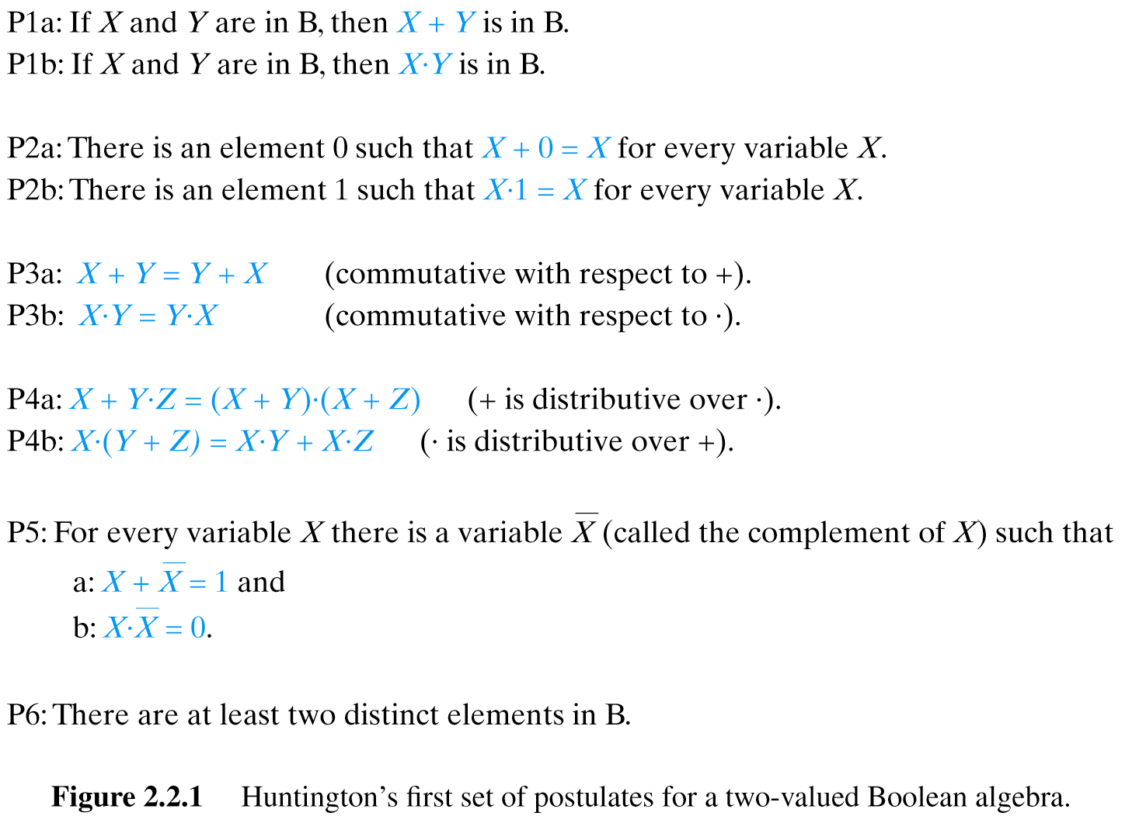
Huntington’s Postulates (I)

Slide 7
Boolean Algebra
Literals
  Variable or Complement of Variable
    X,DoorOpen, Green, Green
Expressions
  Constants (0,1), Literals, Operators
    (X + Y⋅Z), A + B
Precedence
  Complement ( ) , AND (⋅), OR (+)
  () Can be used to modify order

Slide 8
Operators
Complement (NOT)
  A’ /A !A ¬A ~A A
OR
  A + B A | B A ∨ B
AND
  A * B A & B A ⋅ B A ∧ B
For typographical convenience, you’ll see many variations on the symbols used to represent these operations.

Slide 9
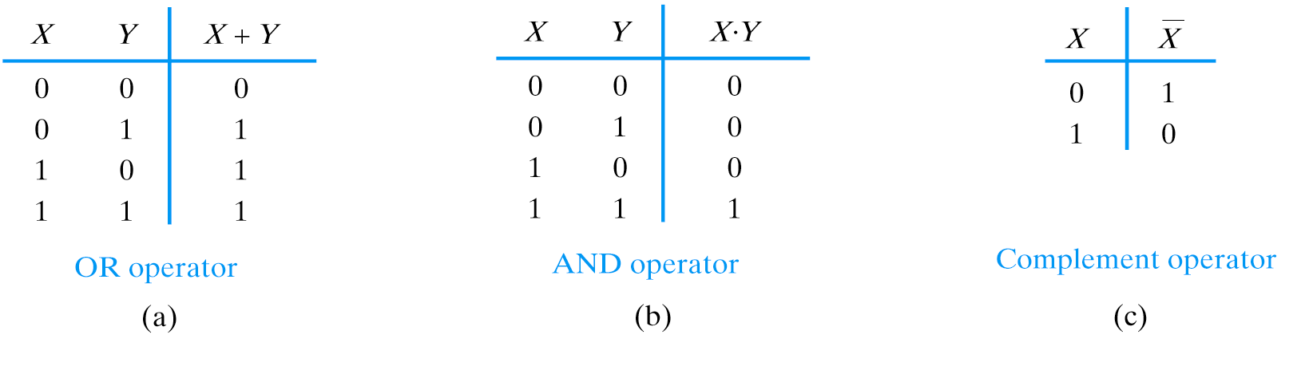
Truth Tables
(NOT)

Slide 10
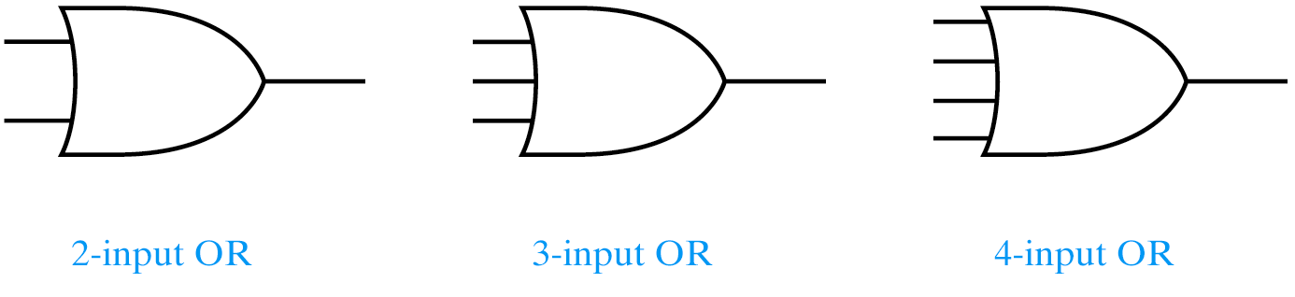
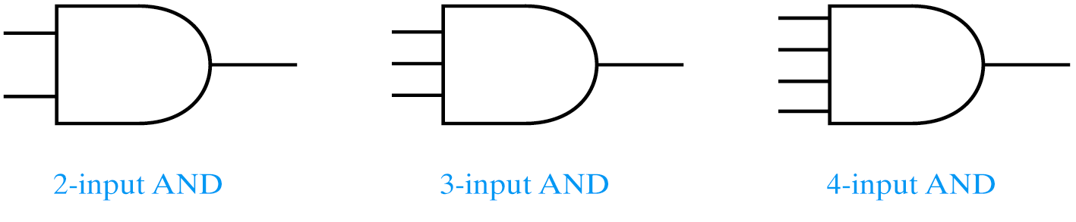
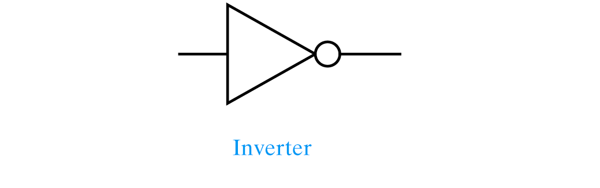
Graphic Symbols
(NOT)
Notes:
Fan-in

Slide 11
Additional Operators
NOR
  A + B A | B A ∨ B
NAND
  A * B A & B A ⋅ B A ∧ B
Notes:
For typographical convenience, you’ll see many variations on the symbols used to represent these operations.

Slide 12
Truth Tables
X Y X + Y
0 0 1
0 1 0
1 0 0
1 1 0
X Y X ⋅ Y
0 0 1
0 1 1
1 0 1
1 1 0
NOR operator
NAND operator

Slide 13
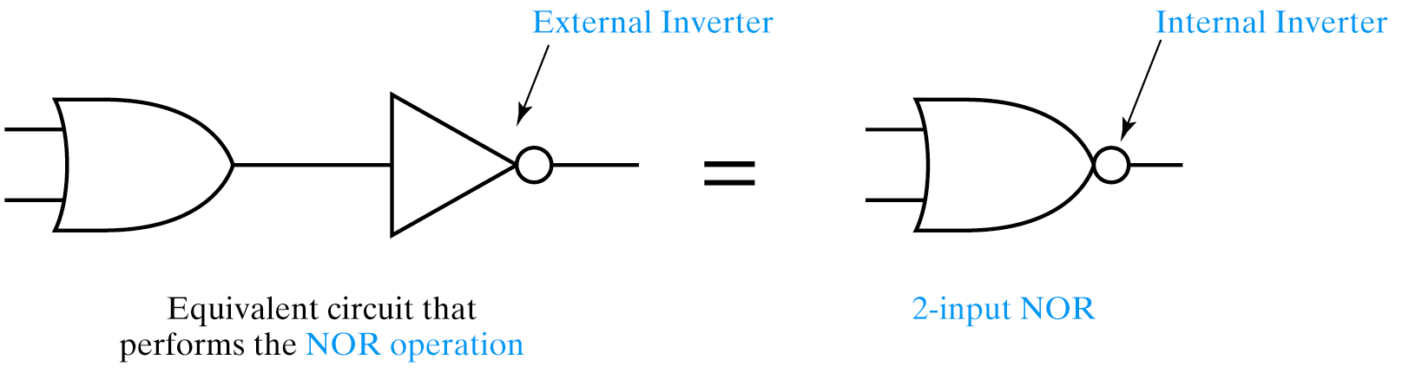
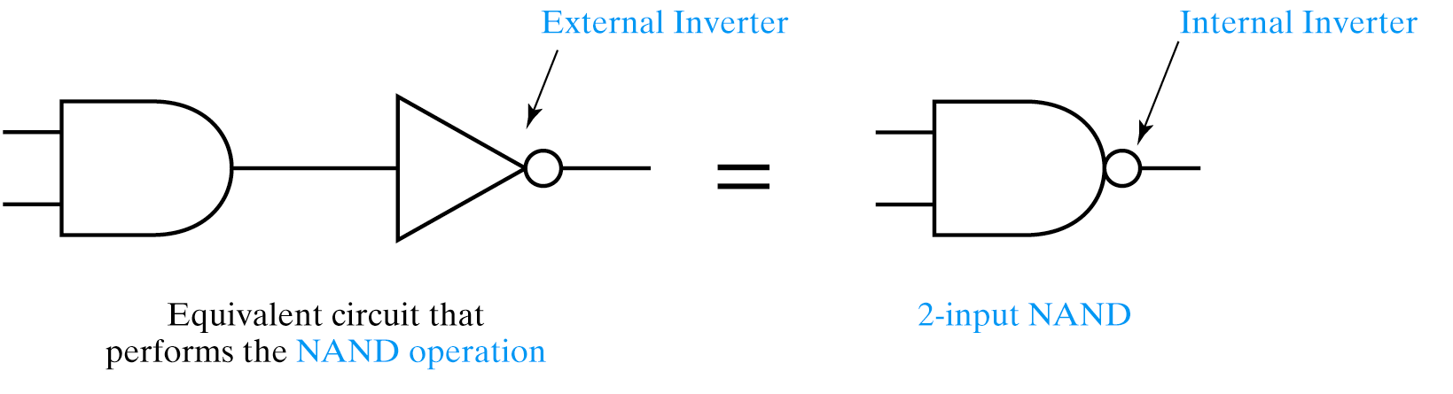
Graphic Symbols

Slide 14
Additional Operators: XOR and XNOR
XOR (Exclusive OR, Modulo 2)
  A ⊕ B
XNOR (Exclusive NOR, Equivalence)
  A ⊕ B
Notes:
For typographical convenience, you’ll see many variations on the symbols used to represent these operations.

Slide 15
Truth Tables
X Y X ⊕ Y
0 0 0
0 1 1
1 0 1
1 1 0
X Y X ⊕ Y
0 0 1
0 1 0
1 0 0
1 1 1
XOR operator
XNOR operator

Slide 16
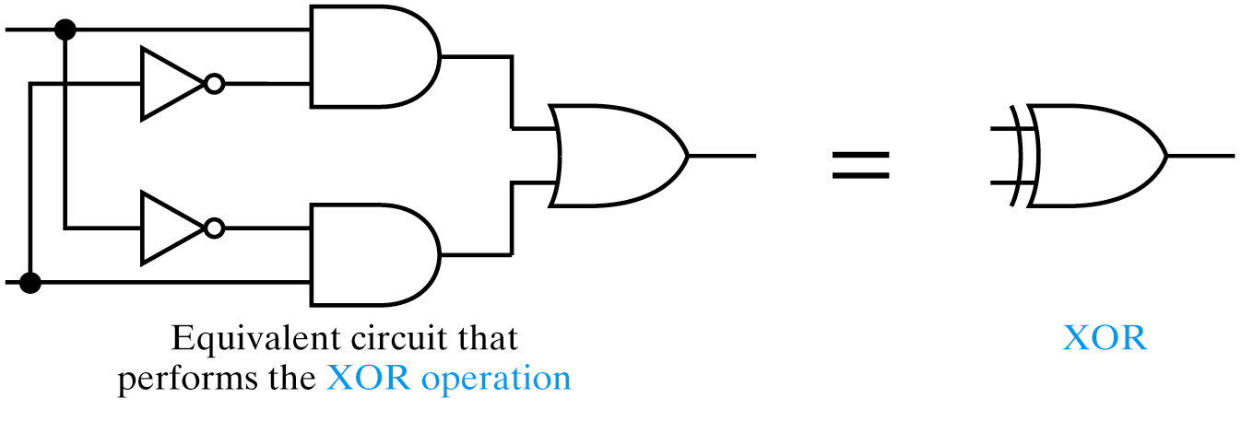
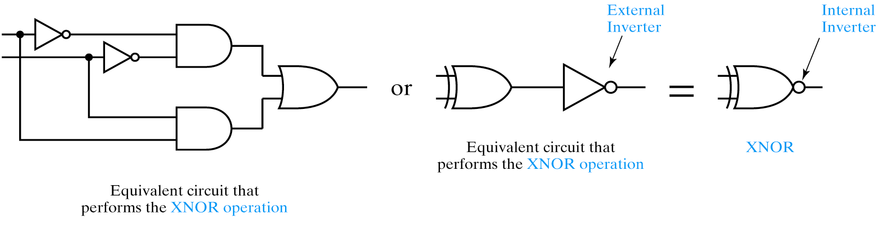
Graphic Symbols

Slide 17
Boolean Functions
Product Terms
  Comprised of literals (including complements), AND
  X⋅Y⋅Z A⋅B⋅C
Sum Terms
  Comprised of literals (including complements), OR
  X + Y + Z A + B + C
Sum of Products (SOP)
  X⋅Y + X⋅Z -- note: parentheses not needed
Product of Sums (POS)
  (X + Y) ⋅ (X + Z)
F(X,Y,Z) = Boolean function of 3 variables: X,Y,Z

Slide 18
Truth Tables
Question: How many rows are there in a truth table
for n variables?
2^{n}
0
1
2
3
.
.
.
63
B₅ B₄ B₃ B₂ B₁ B₀ F
0 0 0 0 0 0 0
0 0 0 0 0 1 1
0 0 0 0 1 0 1
0 0 0 0 1 1 0
.
.
.
1 1 1 1 1 1 1
As many rows as unique combinations
of inputs
Enumerate by counting in binary
2⁶ = 64

Slide 19
Boolean Algebra -- Manipulation
Simplify
  Literal Count Reduction
  Reduce Number of Terms
Transform: Put in Preferred Form
  AND/OR
  NAND/NOR
Can apply Huntington’s Postulates and Theorems to Simplify or Transform Boolean equations

Slide 20
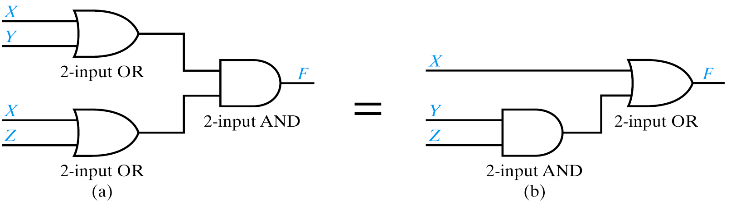
Reducing Number of Terms
F = (X + Y) ⋅ (X + Z)
= X + Y⋅Z
Huntington’s Postulate P4a
Next slide has theorems of Boolean Logic.
Don’t have to memorize these, but should be able to apply them

Slide 21
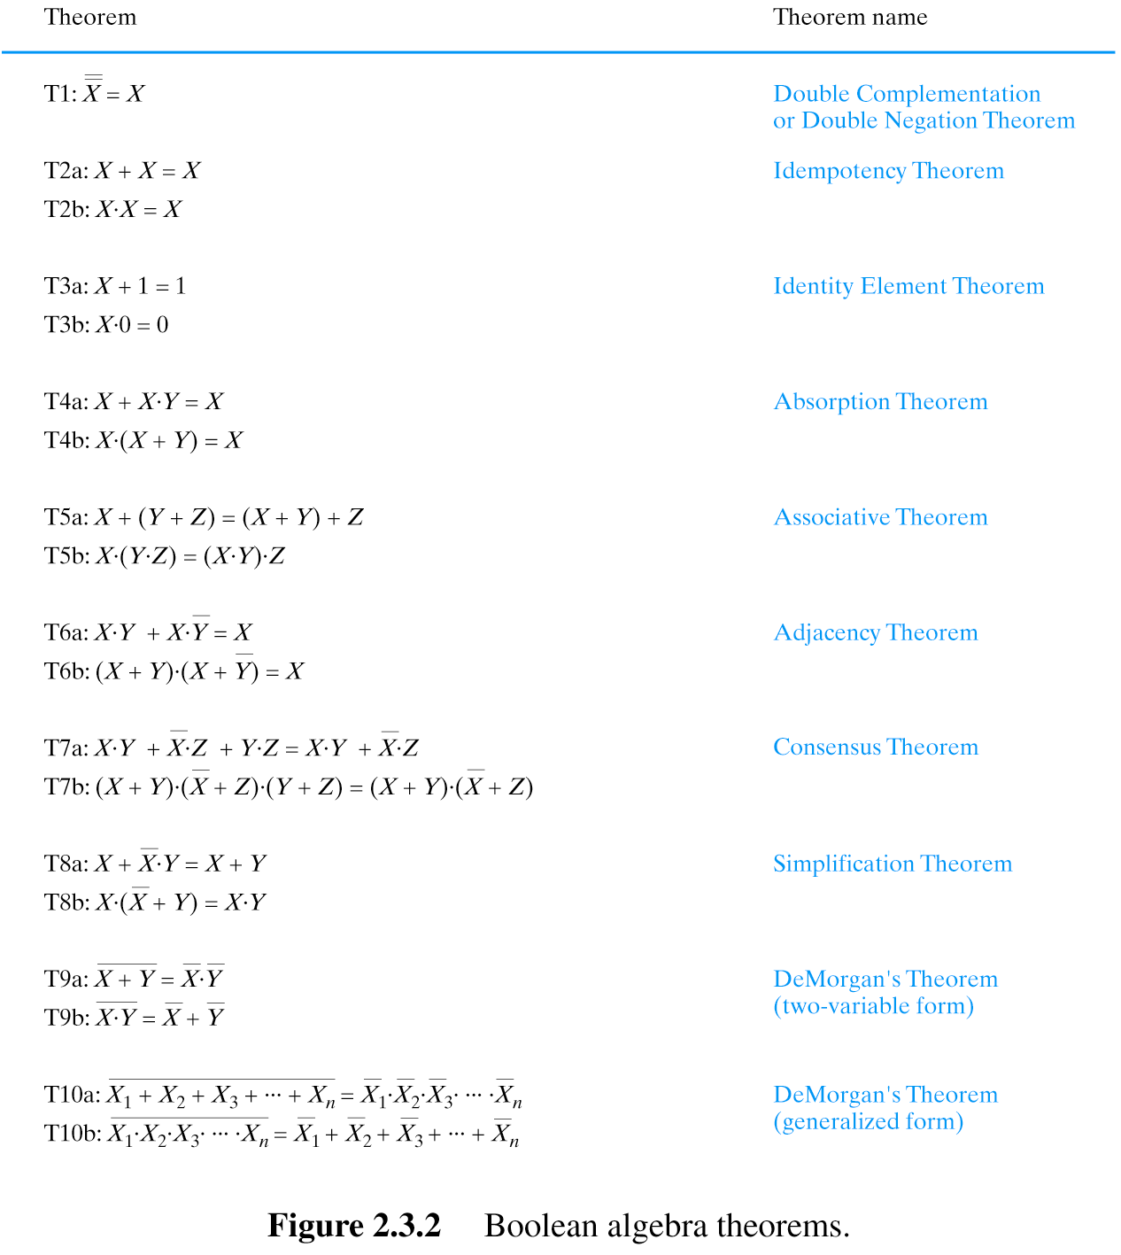
Boolean Theorems

Slide 22
Boolean Theorems: let us discuss each of them

Slide 23
Boolean Theorems (cont)

Slide 24
Literal Count Reduction
F = X⋅Y + X + Y⋅Z
= Y + X + Y⋅Z
= Y + X
Simplification Theorem
Absorption Theorem
Simplification Theorem
X⋅Y + X = Y + X
Y + Y⋅Z= Y(1+Z) = Y⋅ 1 = Y
Absorption Theorem
Y + Y⋅Z = Y

Slide 25
De Morgan’s Theorems
F = X ⋅ Y ⋅ Z
= X + Y + Z
deMorgan’s Theorem
F = X + Y + Z
= X ⋅ Y ⋅ Z
deMorgan’s Theorem
From implementation with NAND gate to NOR and Inverters

Slide 26
Proofs
Using Boolean Algebra
Prove: X + X = X
X + X = (X + X) ⋅ 1 Huntington P2b: X ⋅ 1 = X
= (X + X) ⋅ (X + X) Huntington P5a: X + X = 1
= X + X⋅X Huntington P4a: X + YZ = (X + Y) ⋅ (X + Z)
= X + 0 Huntington P5b: X ⋅ X = 0
= X Huntington P2a: X + 0 = X
Using Principle of Perfect Induction
  Truth Tables!
Q.E.D.

Slide 27
Principle of Perfect Induction
Prove: X⋅Y + X⋅Z + Y⋅Z = X⋅Y + X⋅Z
X Y Z X⋅Y X⋅Z Y⋅Z X⋅Y X⋅Z
0 0 0 0 + 0 + 0 = 0 0 + 0 = 0
0 0 1 0 + 1 + 0 = 1 0 + 1 = 1
0 1 0 0 + 0 + 0 = 0 0 + 0 = 0
0 1 1 0 + 1 + 1 = 1 0 + 1 = 1
1 0 0 0 + 0 + 0 = 0 0 + 0 = 0
1 0 1 0 + 0 + 0 = 0 0 + 0 = 0
1 1 0 1 + 0 + 0 = 1 1 + 0 = 1
1 1 1 1 + 0 + 1 = 1 1 + 0 = 1

Slide 28
Sources
Prof. Mark G. Faust
John Wakerly

